Slide 1
ISM and Star formation

Slide 2
The gas and dust in the interstellar space is called the Inter Stellar Medium (ISM) and it is the major constituent of our galaxy
Objectives:
After studying this unit, you should be able to: • describe the basic composition of ISM; • derive Jeans criterion for the stability of a gas cloud; • explain the necessity of repeated fragmentation of a collapsing cloud; and • discuss the evolution of an interstellar cloud into a pre-main sequence star.

Slide 3
BASIC COMPOSITION OF INTERSTELLAR MEDIUM
The interstellar medium (ISM) makes up only 10 to 15 percent of the visible mass of the Milky Way Galaxy. It comprises matter in the form of gas and dust (very tiny solid particles). About 99 percent of ISM is gas and the rest is dust.
Interstellar Gas: Hydrogen and helium are the two major constituents of interstellar gas; hydrogen constitutes about 70 percent and the rest is helium. Indeed, other elements are also present but in very small quantities. The analysis of the radiation received from ISM has enabled astronomers to classify the gaseous matter filling the interstellar space into the following four types: i) H II region, ii) H I region, iii) Inter-cloud medium, and iv) Molecular cloud.

Slide 4
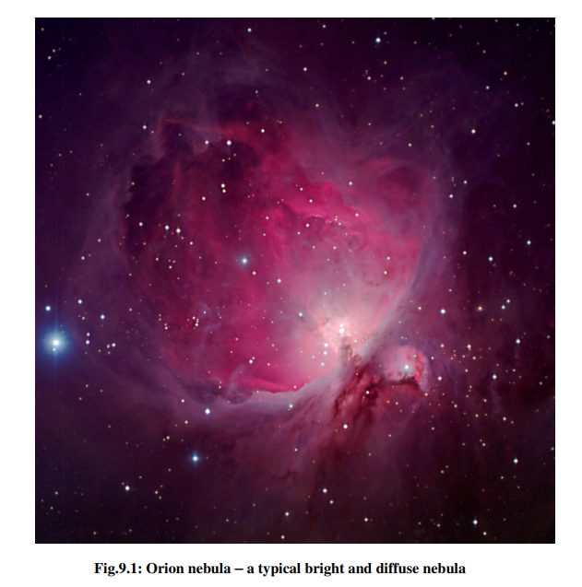
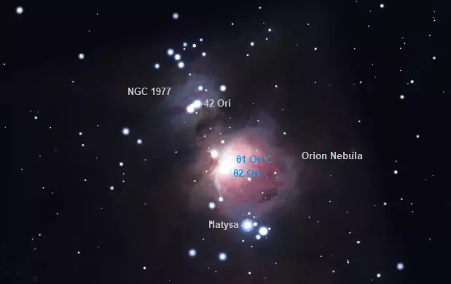
H II region: As the name suggests, these regions of ISM mainly consist of (singly) ionised hydrogen. In addition, these regions contain ions of other elements such as oxygen and nitrogen and free electrons. Since the ionisation energy of hydrogen atom is very high, such regions can exist only in the vicinity of very hot stars.
H II regions are hot, with typical temperatures of 10 000 K, and densities of 10 to 100 000 atom/cm³ (i.e. 10–100 000 times denser than H I regions). They are usually found around massive young O and B stars, the strong ultraviolet light from which ionizes the gas, causing it to glow.

Slide 5
ii) H I region: Although it has been generally believed by astronomers that hydrogen atoms populate interstellar space, they could not detect H I gas till 1951. The reasons are obvious: it is not possible for the neutral hydrogen in ISM to produce emission line as it is in the ground state. However, with the development of radio telescopes, it is now possible to detect H I region. The detection of H I in the ISM is based on the detection of a unique radiation of wavelength 21 cm.
Calculate the energy of electromagnetic radiation having wavelength 21-cm.

Slide 6
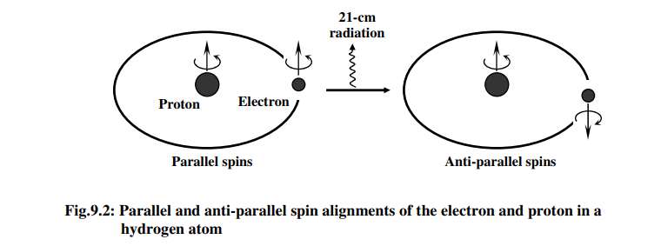
What kind of transition produces such a low energy photon? In a hydrogen atom, an electron revolves around the proton. Since the proton and the electron possess spin, there are two possible ways for their spins to align with respect to each other. The two spins may be parallel (aligned) or anti-parallel (anti-aligned) (Fig. 9.2). It is known that the parallel spin state of hydrogen atom has slightly more energy than the anti-parallel spin state. Therefore, if there is a flip from the parallel to the antiparallel state, there is a loss in energy of the hydrogen atom and it results in the emission of a photon. The frequency and the wavelength of such emissions are 1420 MHz and 21 cm, respectively.

Slide 7
Can we obtain 21-cm radiation in laboratory conditions?
It is not possible because the best vacuum that can be produced in a laboratory has a much higher density of atoms than that found in the ISM. So, in laboratory conditions, practically all the hydrogen atoms get de-excited due to higher collision rate and we cannot obtain 21-cm line. Thus, the only place where favourable conditions for emission of such radiations can exist is outer space. The 21-cm line was first detected in the year 1951 using a radio telescope even though it was predicted as early as in the 1940s. Since its detection, it has become a common tool in astronomy to map the location and densities of H I regions. This helps in determining the structure of galaxies including our own. Investigations of diffuse interstellar H I clouds suggest that their temperatures are in the range of 30 – 80 K, masses in the range of 1 – 100 solar masses and the number densities in the range of 10- 100 cm −3 .

Slide 8
iii) Inter-cloud Medium:
Is the space between the interstellar clouds empty?
It is not so; the inter-cloud space consists of a) neutral hydrogen gas with a density of 10^5 atoms m−3 , and b) hot (~ 8000 K) ionised gas with very low density (~ 10^4 ions m−3 ). You would further like to know: Is there any interaction between the H I clouds and the inter-cloud medium? The H I clouds are very cool and have high densities whereas inter-cloud medium has very low density and high temperature. The pressure of a region, being a function of its density and temperature, in the H I clouds and in the inter-cloud medium is about the same and they are in equilibrium.

Slide 9
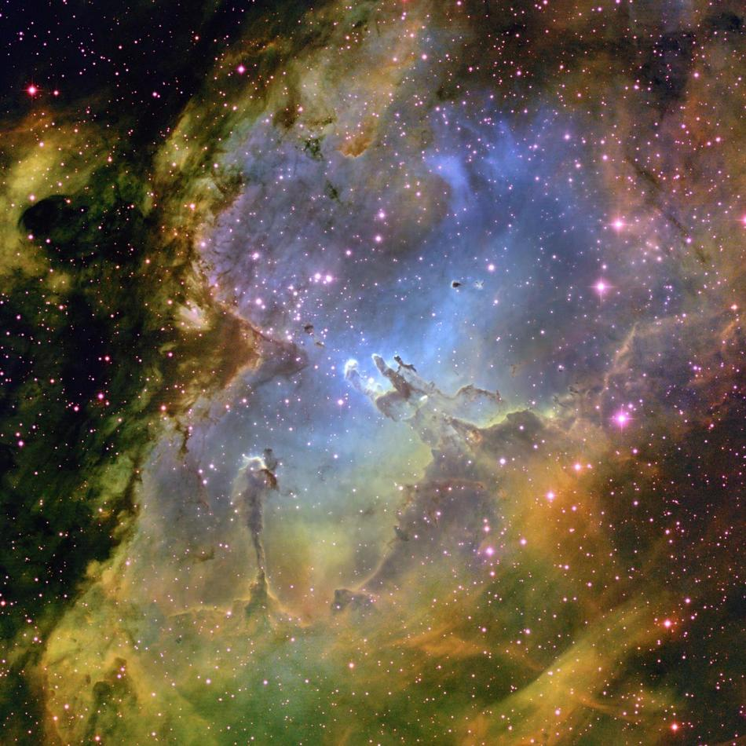
iv) Molecular Cloud: Analysis of optical spectra of interstellar medium reveals that matter exists in molecular form in ISM. Since hydrogen is the most abundant matter in ISM, it mainly consists of the hydrogen molecules (H2). However, molecules of hydrogen do not emit photons of radio wavelength and vast clouds of hydrogen molecules remain undetected by radio spectroscopy. Other molecules, such as CO (carbon monoxide), capable of emitting in radio wavelength, can indeed be detected. In fact, nearly 100 such molecules have been detected. But the basic question is: How do these molecules form in ISM? It is believed that the atoms come in the vicinity of each other and bond to form molecules on the surfaces of the dust grains (about which you will learn later in this Section). These molecules are very weakly bonded and can be easily broken by high energy photons. Thus, they can exist only deep inside dense clouds. Also, efficient release of energy by molecules makes these dense clouds very cool. These dense, cold clouds are called molecular clouds. These clouds have very low temperatures of just 10 to 30 kelvin
The size of these molecular clouds can be from a few light years up to 600 light years and their total mass can reach several million solar masses. Molecular clouds with dimensions of more than about 15 light years are also called giant molecular clouds.

Slide 10
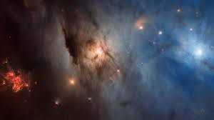
Molecular clouds are so important because they are the raw material of stars and planets. A dark nebula (or dark cloud) is a very dense part of a bigger molecular cloud; the light extinction is caused by the high density and the presence of interstellar dust in these clouds. These are the regions where new stars are forming. Such a density can only occur if the temperatures are very low, otherwise the thermal pressure of the gas would lead to an expansion of the dark nebula and no new stars would be able to form. They mainly consist of hydrogen and dust particles which are all you need to form new star systems with stars and planets. Indeed, these clouds often contain newly formed stars; we just cannot see them due to the extinction of visible light caused by the dust of the clouds. Nevertheless, we are able to look into the core of the cloud using radio or infrared wavelengths. This way we can detect the very young stars.
Hundreds of different types of molecules have been detected in these clouds, among them water (H₂O), ammonia (NH₃), ethyl alcohol (C₂H₅OH) and even sugar and amino acids
NGC 1333 – The Star-forming, Perseus Molecular Cloud – As Seen By Hubble

Slide 11
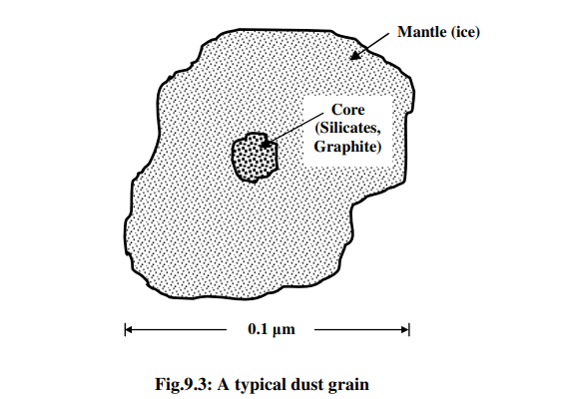
Interstellar Dust: Interstellar medium also contains dust grains, which constitute about one percent of the interstellar mass. Although the temperature of interstellar dust region is very low (~ 100 K), it can be detected by infrared telescopes. A typical dust grain is made of thin, highly flattened flakes of silicates and graphites coated with ice. Fig. 9.3 shows a typical dust grain, which is of the size of the wavelength of blue light.
What is the evidence supporting the existence of dust in ISM? The two observable effects due to dust are extinction and reddening. Refer to Fig. 9.4. Note that, besides the brighter gas and dust regions surrounding the stars, there are darker regions as well. You may think that these regions are devoid of stars. It is not so. In fact, these darker regions are so dense that they completely stop the light emitted by stars behind them and therefore no light is able to pass through. This phenomenon is known as interstellar extinction. The extent to which light is scattered or absorbed in a dust cloud depends on the number density of particles and on its thickness. Fig.9.3: A typical dust gr

Slide 12
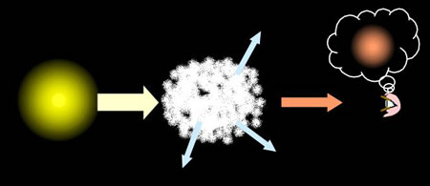
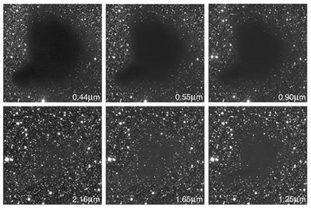
Dust clouds along the line of sight scatter and absorb light coming from distant objects. We therefore see these objects as dimmer and redder than they really are. These effects are known as extinction and interstellar reddening respectively.
Since the typical size of dust grains is of the order of the wavelength of blue light, the blue light from star is scattered more than the red light. As a result, some of the blue light from the star is lost and it appears redder.
The dark cloud, Barnard 68, illustrating that extinction becomes less of a problem as we move from visual wavelengths (top row) to infrared wavelengths (bottom row).

Slide 13
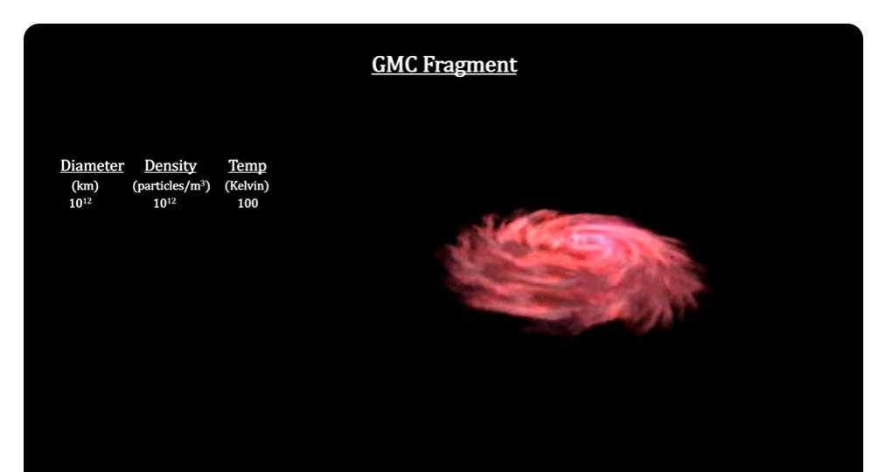
FORMATION OF PROTOSTAR : you learnt that the giant molecular clouds (GMCs) are the likely sites where star formation can take place. However, GMCs are very unlike stars: their typical diameter is 50 pc, typical mass exceeds 10^5 solar masses and their density is 10^20 times less than a typical star. Thus, the question is: How do stars form from such molecular clouds? The simplest answer to this question is that the stars form due to gravity: a cloud of gas contracts due to self-gravity. This contraction increases density and temperature of the core, initiating generation of nuclear energy. You may ask : How do we reconcile the typical mass of a star with the mass of a GMC (~ 105 solar mass)? This problem was addressed by Jeans who proposed a criterion for the mass of a contracting cloud which may evolve into a star.
https://www.youtube.com/watch?v=58qRXKqleIk

Slide 14


Jeans Criterion
Jeans proposed that there are two competing processes in the gravitational collapse of a molecular cloud. On the one hand, the gravitational contraction increases the internal pressure of the cloud which tends to expand the cloud. On the other hand, gravity acts on the cloud and tends to further contract it. Which of these two processes will dominate is determined by the mass of the cloud. If the internal pressure is more than the gravitational force, the cloud will break up. A clump of cloud must have a minimum mass to continue collapsing and give birth to a star. This minimum mass is called the Jeans mass. It is a function of density and temperature.
To obtain an expression for the Jeans mass, we make the following simplifying assumptions: i) the cloud is uniform and non-rotating; ii) the cloud is non-magnetic; and iii) the gas and dust is confined to a certain region of space by the gravitational force and is in hydrostatic equilibrium.
Here MJ is called the Jeans mass and Eq. is known as Jeans criterion. The Jeans mass is the minimum mass needed for a cloud to balance its internal pressure with self-gravity; clouds with greater mass will collapse.
Jeans length, RJ

Slide 15
A collapsing cloud is made of neutral hydrogen (H I) only. If the temperature of the cloud is 50 K and its number density is 105 m −3 , calculate its Jeans mass.
How long does it take for a cloud to collapse?(free fall time)
a particle on the surface of a star of mass M and radius R experiences an acceleration g given by

Slide 16
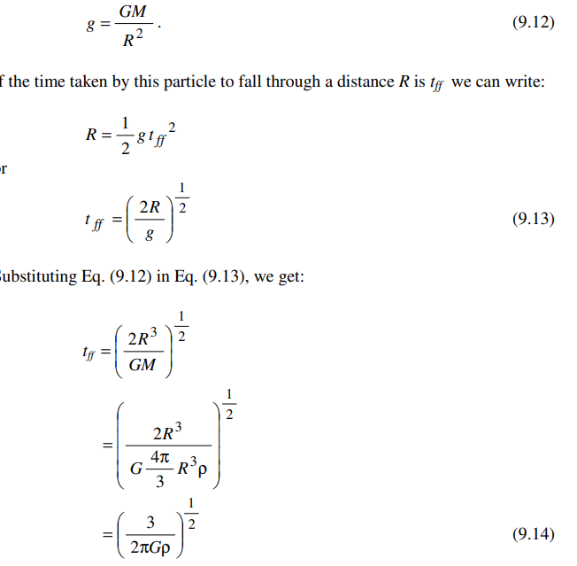
How long does it take for a cloud to collapse?(free fall time)
a particle on the surface of a star of mass M and radius R experiences an acceleration g given by

